Slide 1
Math Presentation
Differential Calculus

Slide 2
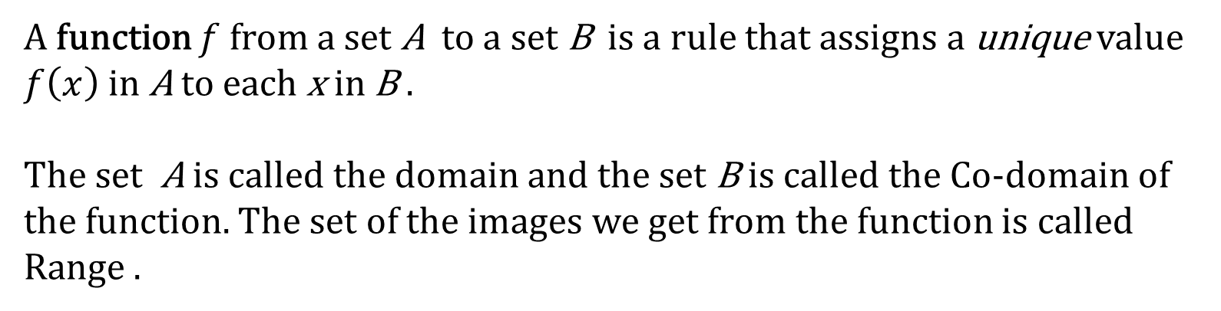
Definition of Function
A function $f$ from a set A to a set B is a rule that assigns a unique value $f\left(x\right)$ in A to each x in B .
The set A is called the domain and the set B is called the Co-domain of the function. The set of the images we get from the function is called Range .

Slide 3
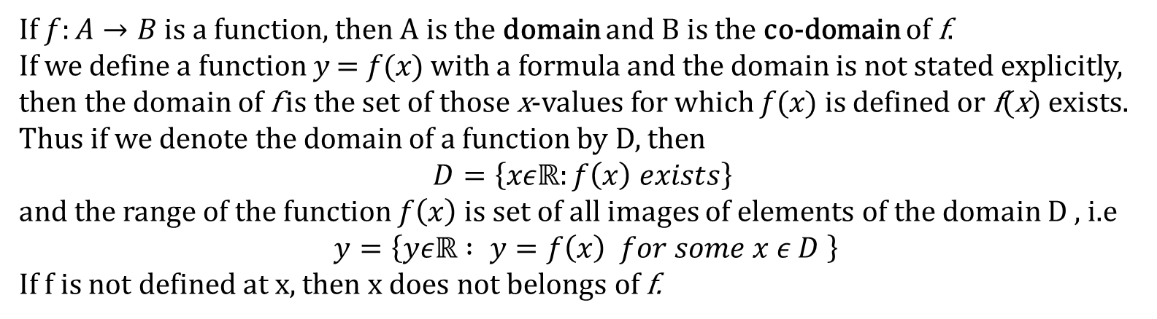
Domain , Co-domain & Range of Function
If $f:A→B$ is a function, then A is the domain and B is the co-domain of f.
If we define a function 𝑦 = 𝑓(𝑥) with a formula and the domain is not stated explicitly,
then the domain of f is the set of those x-values for which 𝑓(𝑥) is defined or f(x) exists.
Thus if we denote the domain of a function by D, then
$$D=\left\{xεℝ:f\left(x\right) exists\right\}$$
and the range of the function $f\left(x\right)$ is set of all images of elements of the domain D , i.e
$y=\left\{yεℝ : y=f\left(x\right) for some x ε D \right\}$
If f is not defined at x, then x does not belongs of f.

Slide 4
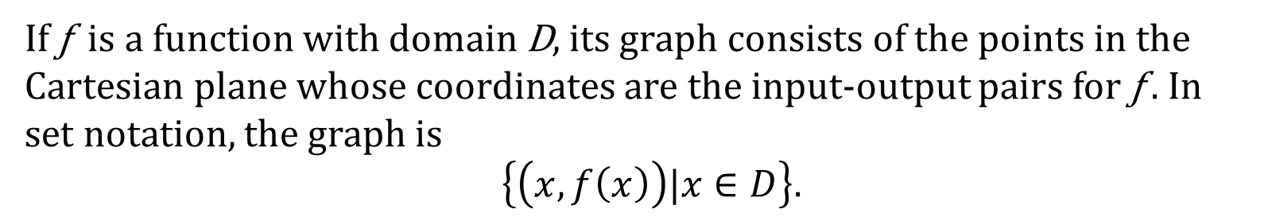
Graph of a Function
If ƒ is a function with domain D, its graph consists of the points in the Cartesian plane whose coordinates are the input-output pairs for ƒ . In set notation, the graph is
$\left\{\left(x,f\left(x\right)\right)|x∈D\right\}.$

Slide 5
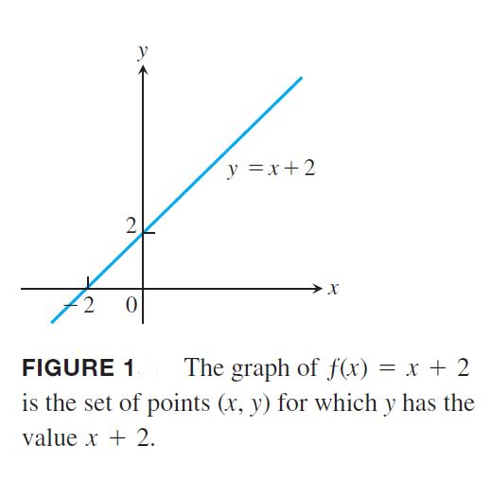
Example
The graph of the function ƒ(x) = x + 2 is the set of points with coordinates
(x, y) for which y = x + 2. Its graph is the straight line sketched in Figure 1.

Slide 6
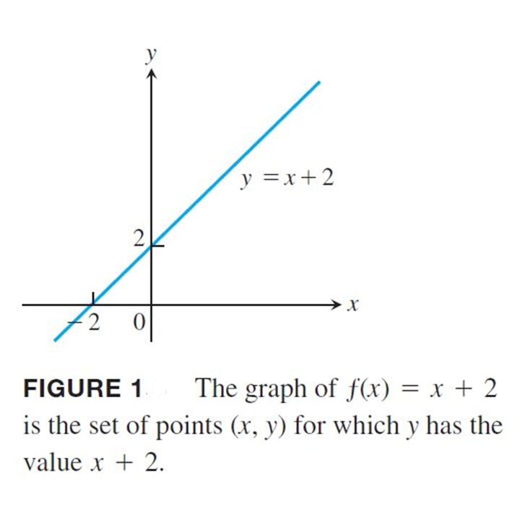
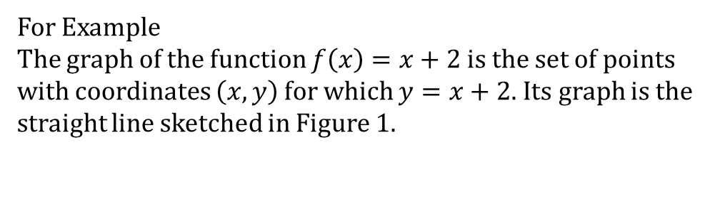
Graph of a Function
If $f$ is a real-valued function of a real variable, then the graph of f in the xy-plane is
defined to be the graph of the equation $y=f\left(x\right)$.
For Example
The graph of the function $f\left(x\right)=x+2$ is the set of points with coordinates $\left(x,y\right)$ for which $y=x+2$. Its graph is the straight line sketched in Figure 1.

Slide 7
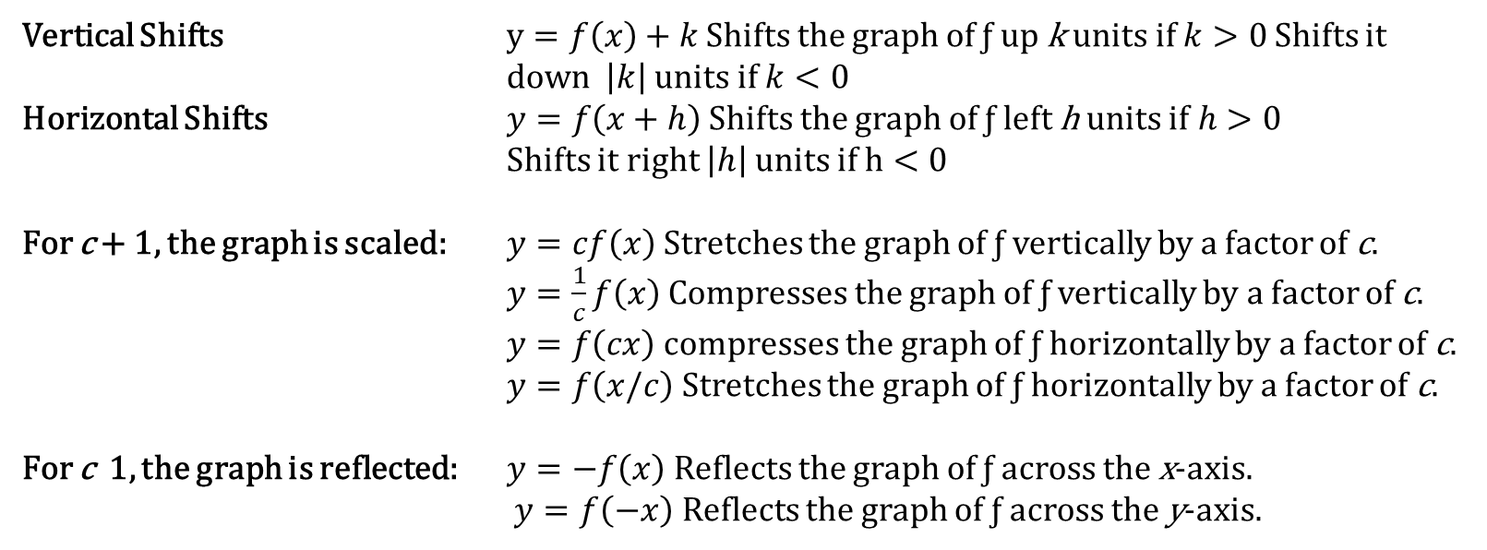
Shifting of Graphs
Vertical Shifts $y=f\left(x\right)+k$ Shifts the graph of ƒ up k units if $k>0$ Shifts it down $\left|k\right|$ units if $k<0$
Horizontal Shifts $y=f\left(x+h\right)$ Shifts the graph of ƒ left h units if$h>0$
Shifts it right $\left|h\right|$ units if $h<0$
For c + 1, the graph is scaled: $y=cf\left(x\right)$ Stretches the graph of ƒ vertically by a factor of c.
$y=\frac{1}{c}f\left(x\right)$ Compresses the graph of ƒ vertically by a factor of c.
$y=f\left(cx\right)$ compresses the graph of ƒ horizontally by a factor of c.
$y=f\left(x/c\right)$ Stretches the graph of ƒ horizontally by a factor of c.
For c 1, the graph is reflected: $y=−f\left(x\right)$ Reflects the graph of ƒ across the x-axis.
$y=f\left(−x\right)$ Reflects the graph of ƒ across the y-axis.

Slide 8
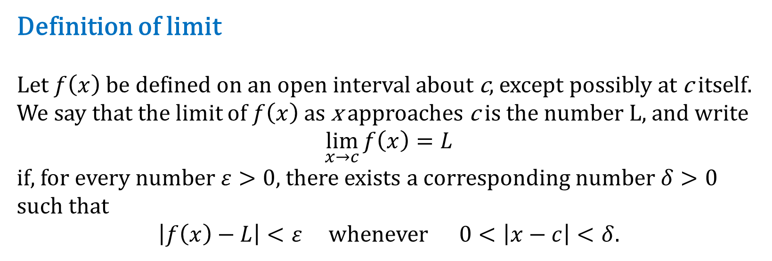
Definition of limit
Let $f\left(x\right)$ be defined on an open interval about c, except possibly at c itself. We say that the limit of $f\left(x\right)$ as x approaches c is the number L, and write
$\lim_{x→c}{f\left(x\right)=L}$
if, for every number $ε>0$, there exists a corresponding number $δ>0$ such that
$\left|f\left(x\right)−L\right|<ε$ whenever $0<\left|x−c\right|<δ$.

Slide 9
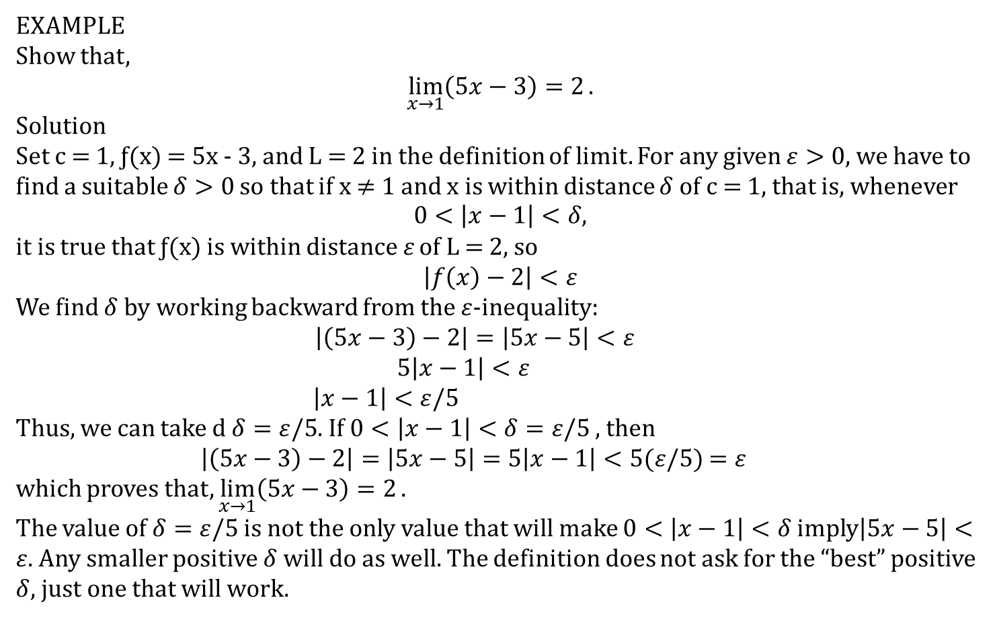
EXAMPLE
Show that,
$$\lim_{x→1}\left(5x−3\right)=2.$$
Solution
Set c = 1, ƒ(x) = 5x - 3, and L = 2 in the definition of limit. For any given $ε>0$, we have to find a suitable $δ>0$ so that if x ≠ 1 and x is within distance $δ$ of c = 1, that is, whenever
$$0<\left|x−1\right|<δ,$$
it is true that ƒ(x) is within distance $ε$ of L = 2, so
$$\left|f\left(x\right)−2\right|<ε$$
We find $δ$ by working backward from the $ε$-inequality:
$$\left|\left(5x−3\right)−2\right|=\left|5x−5\right|<ε$$
$5\left|x−1\right|<ε$
$\left|x−1\right|<ε/5$
Thus, we can take d $δ=ε/5$. If $0<\left|x−1\right|<δ=ε/5$ , then
$\left|\left(5x−3\right)−2\right|=\left|5x−5\right|=5\left|x−1\right|<5(ε/5)$ $=ε$
which proves that, $\lim_{x→1}\left(5x−3\right)=2.$
The value of $δ=ε/5$ is not the only value that will make $0<\left|x−1\right|<δ$ imply$\left|5x−5\right|<ε$. Any smaller positive $δ$ will do as well. The definition does not ask for the “best” positive $δ$, just one that will work.

Slide 10
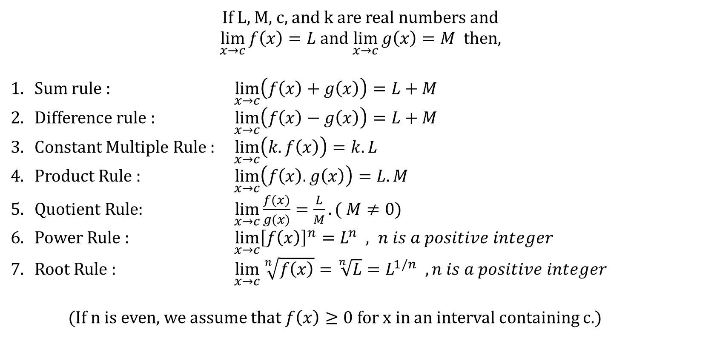
Basic Limit Laws
If L, M, c, and k are real numbers and
$\lim_{x→c}{f\left(x\right)=L}$ and $\lim_{x→c}{g\left(x\right)=M}$ then,
Sum rule : $\lim_{x→c}\left(f\left(x\right)+g\left(x\right)\right)=L+M$
Difference rule : $\lim_{x→c}\left(f\left(x\right)−g\left(x\right)\right)=L+M$
Constant Multiple Rule : $\lim_{x→c}\left(k.f\left(x\right)\right)=k.L$
Product Rule : $\lim_{x→c}\left(f\left(x\right).g\left(x\right)\right)=L.M$
Quotient Rule: $\lim_{x→c}{\frac{f(x)}{g(x)}=\frac{L}{M}}. ( M≠0)$
Power Rule : $\lim_{x→c}{{\left[f\left(x\right)\right]}^{n}=L^{n} , n is a positive integer }$
Root Rule : $\lim_{x→c}{\sqrt[n]{f\left(x\right)}=\sqrt[n]{L}=L^{1/n} , n is a positive integer}$
(If n is even, we assume that $f\left(x\right)≥0$ for x in an interval containing c.)

Slide 11

Existance at any point
There exists limit of a function $f\left(x\right)$ at a point x=a , if
$\lim_{x→a^{+}}{f\left(x\right)=\lim_{x→a^{−}}{f\left(x\right)}}$
Then there exists a limit $\lim_{x→a}{f\left(x\right)}$

Slide 12
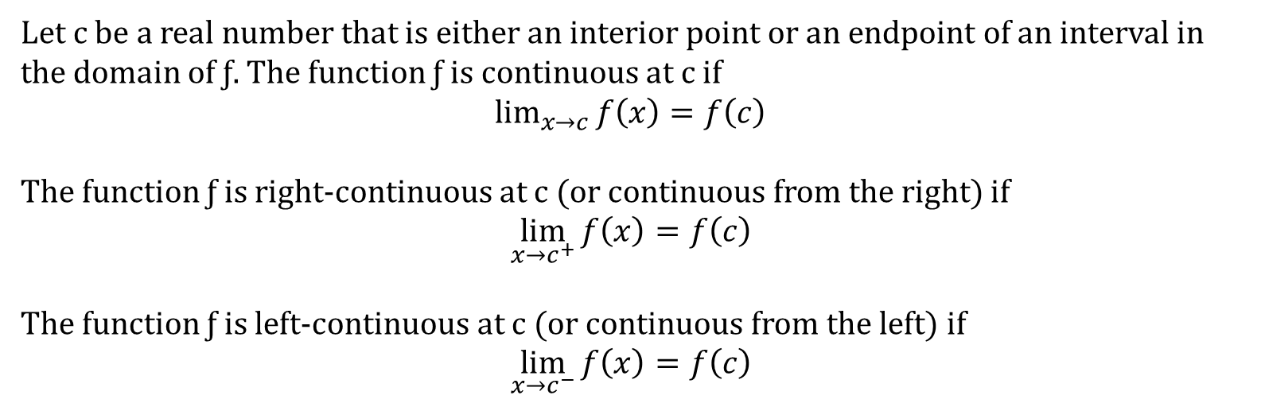
Continuity at a point
Let c be a real number that is either an interior point or an endpoint of an interval in the domain of ƒ. The function ƒ is continuous at c if
$\lim_{x→c}{f\left(x\right)}=f\left(c\right)$
The function ƒ is right-continuous at c (or continuous from the right) if
$\lim_{x→c^{+}}{f\left(x\right)}=f\left(c\right)$
The function ƒ is left-continuous at c (or continuous from the left) if
$\lim_{x→c^{−}}{f\left(x\right)}=f\left(c\right)$

Slide 13
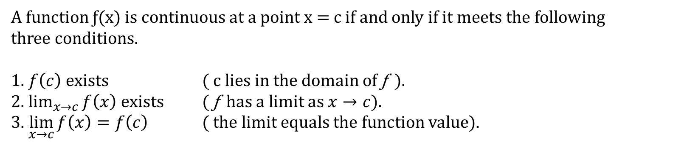
Continuity Test
A function ƒ(x) is continuous at a point x = c if and only if it meets the following
three conditions.
1. $f\left(c\right)$exists ( c lies in the domain of ƒ ).
2. $\lim_{x→c}{f\left(x\right)}$ exists ( ƒ has a limit as $x→c$).
3. $\lim_{x→c}{f\left(x\right)}=f\left(c\right)$ ( the limit equals the function value).

Slide 14
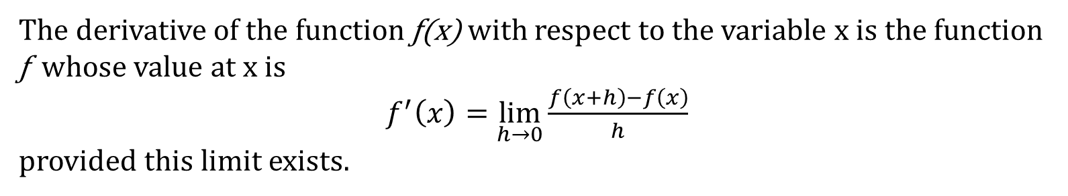
Derivatives of Function
The derivative of the function ƒ(x) with respect to the variable x is the function ƒ whose value at x is
$f^{′}\left(x\right)=\lim_{h→0}{\frac{f\left(x+h\right)−f\left(x\right)}{h}}$
provided this limit exists.

Slide 15
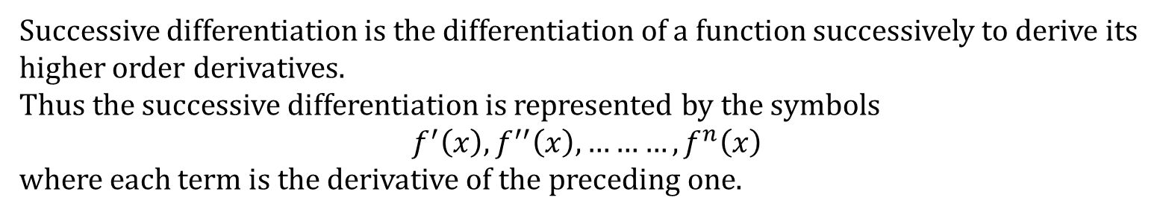
Successive Differentiation
Successive differentiation is the differentiation of a function successively to derive its higher order derivatives.
Thus the successive differentiation is represented by the symbols
$$f^{′}\left(x\right),f^{′′}\left(x\right),………,f^{n}\left(x\right)$$
where each term is the derivative of the preceding one.

Slide 16
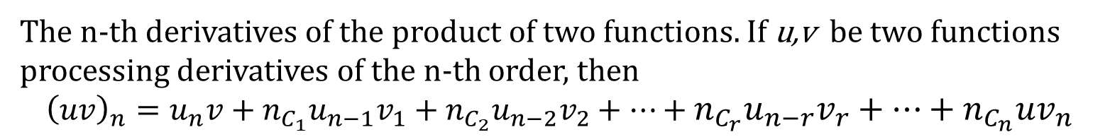
Libnitz’s Theorem
The n-th derivatives of the product of two functions. If u,v be two functions processing derivatives of the n-th order, then
$${\left(uv\right)}_{n}=u_{n}v+n_{C_{1}}u_{n−1}v_{1}+n_{C_{2}}u_{n−2}v_{2}+…+n_{C_{r}}u_{n−r}v_{r}+…+n_{C_{n}}uv_{n}$$

Slide 17
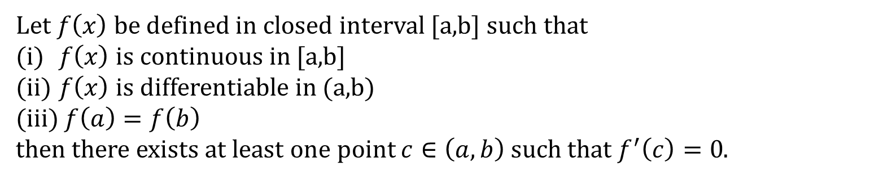
Rolle’s Theorem
Let $f\left(x\right)$ be defined in closed interval [a,b] such that
$f\left(x\right)$ is continuous in [a,b]
$f\left(x\right)$ is differentiable in (a,b)
$f\left(a\right)=f\left(b\right)$
then there exists at least one point $c∈\left(a,b\right)$ such that $f^{′}\left(c\right)=0$.

Slide 18
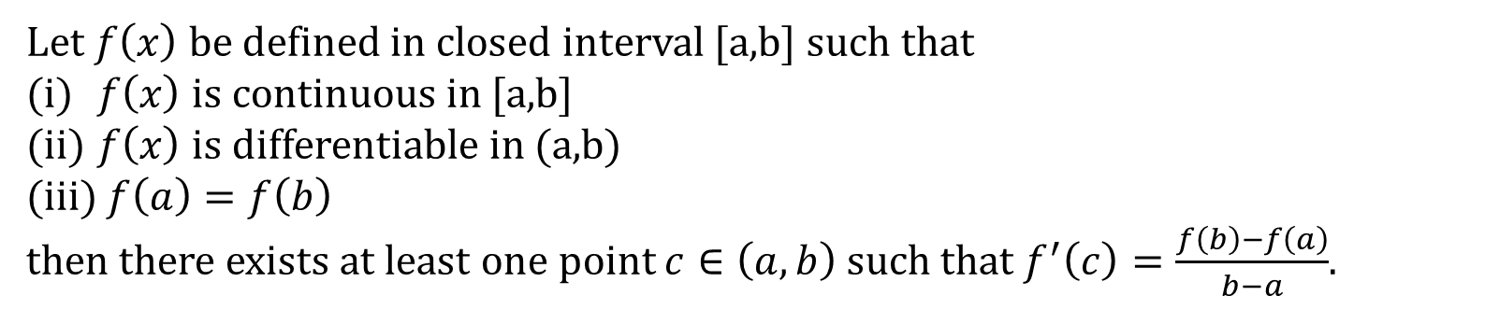
Mean Value Theorem (Lagrange’s form)
Let $f\left(x\right)$ be defined in closed interval [a,b] such that
$f\left(x\right)$ is continuous in [a,b]
$f\left(x\right)$ is differentiable in (a,b)
$f\left(a\right)=f\left(b\right)$
then there exists at least one point $c∈\left(a,b\right)$ such that $f^{′}\left(c\right)=\frac{f\left(b\right)−f\left(a\right)}{b−a}$.

Slide 19
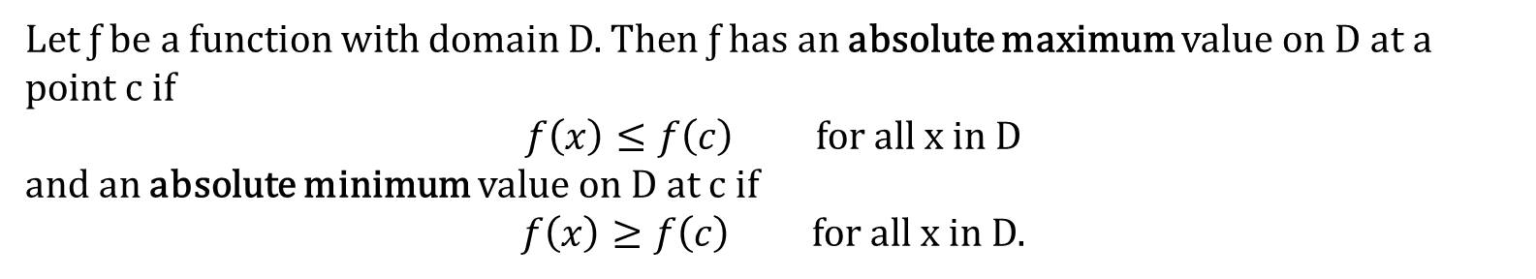
Absolute Maxima & Minima
Let ƒ be a function with domain D. Then ƒ has an absolute maximum value on D at a point c if
$f\left(x\right)≤f\left(c\right)$ for all x in D
and an absolute minimum value on D at c if
$f\left(x\right)≥f\left(c\right)$ for all x in D.

Slide 20
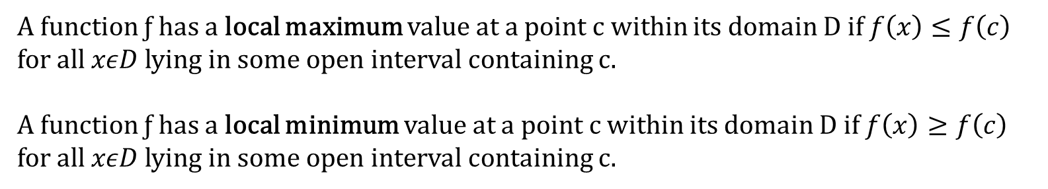
Local Maxima & Minima
A function ƒ has a local maximum value at a point c within its domain D if $f\left(x\right)≤f\left(c\right)$ for all $xεD$ lying in some open interval containing c.
A function ƒ has a local minimum value at a point c within its domain D if $f\left(x\right)≥f\left(c\right)$ for all $xεD$ lying in some open interval containing c.

Slide 21
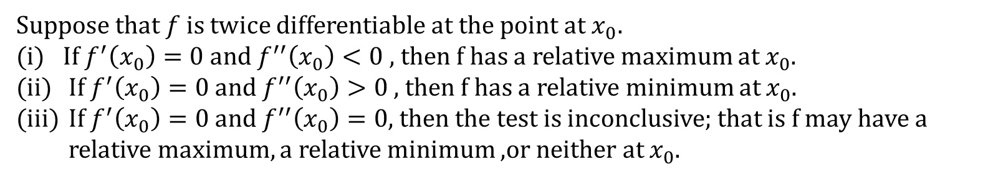
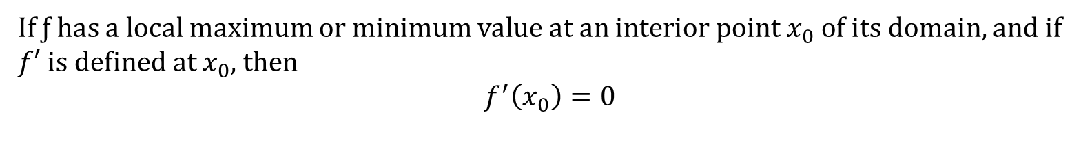
Finding Extrema
If ƒ has a local maximum or minimum value at an interior point $x_{0}$ of its domain, and if $f′$ is defined at $x_{0}$, then
$$f^{′}\left(x_{0}\right)=0$$
Suppose that $f$ is twice differentiable at the point at $x_{0}.$
(i) If $f^{′}\left(x_{0}\right)=0$and $f^{′′}\left(x_{0}\right)<0$, then f has a relative maximum at $x_{0}$.
If $f^{′}\left(x_{0}\right)=0$ and $f^{′′}\left(x_{0}\right)>0$ , then f has a relative minimum at $x_{0}$.
If $f^{′}\left(x_{0}\right)=0$ and $f^{′′}\left(x_{0}\right)=0$, then the test is inconclusive; that is f may have a relative maximum, a relative minimum ,or neither at $x_{0}$.

Slide 22
Syllabus:
Differential Calculus:
Functions of a real variables and their plots;
limit;
continuity and derivatives; -
physical meaning of derivative of a function; -
Leibnitz Theorem; -
Rolle’s Theorem; mean value theorem and Taylor’s theorem (statement only). –
Taylor’s and Maclaurin’s series and expansion of functions; -
maximum and minimum values of functions; -
functions of two or three variables; -
partial and total derivatives.

Slide 23
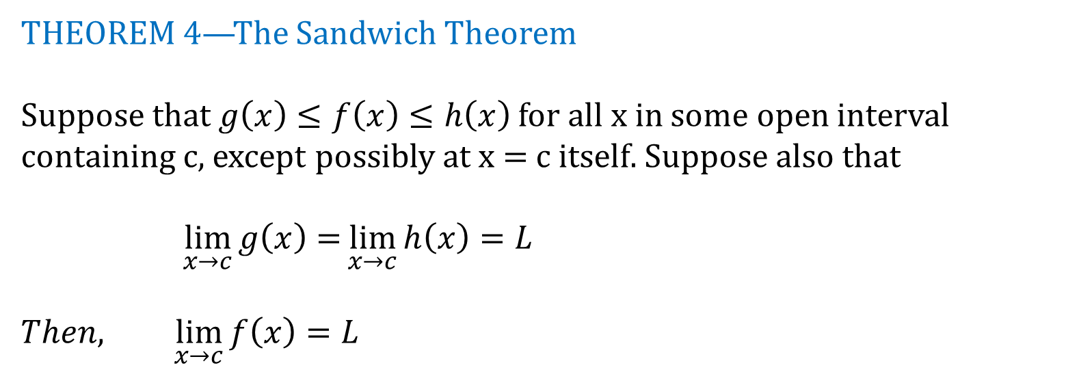
THEOREM 4—The Sandwich Theorem
Suppose that $g\left(x\right)≤f\left(x\right)≤h\left(x\right)$ for all x in some open interval containing c, except possibly at x = c itself. Suppose also that
$\lim_{x→c}{g\left(x\right)=}\lim_{x→c}{h\left(x\right)=L}$
$Then, \lim_{x→c}{f\left(x\right)}=L$

